Slide 1
M3E
Mediterranean Extreme Events Experiment
27/06/2025
Online Meeting
CMCC – OGS - ItaliaMeteo

Slide 2
Annex 1: Outcome of ECMWF meeting in February 2025
M3E - Mediterranean Extreme Events Experiment
Extreme weather events across the Mediterranean Sea can cause significant damages in the surrounding countries (examples Acqua Alta event in Venice in 2019, Storm Alex in October 2020, Storm Daniel in September 2023, and flooding in the Emilia-Romagna region in 2023 and 2024)
Scientific question : in the future could more accurate forecasts of these types of storms be provided if additional observations were added across the Mediterranean Sea?
Benefits for countries surrounding the Mediterranean by providing improved awareness and warning for such events. Many of these countries are Member and Co-operating States of ECMWF.

Slide 3
Annex 1: Outcome of ECMWF meeting in February 2025
M3E- Mediterranean Extreme Events Experiment
In January/February 2026 there will be a Global Observational Campaign entitled Global Atmospheric River Reconnaissance Campaign (GARRP) whose aim is to investigate whether adding extra observations across the North Pacific and North Atlantic Oceans may increase medium-range weather forecast skill.
These observations include dropsondes from aircraft, radiosondes, and drifting buoys with barometers. Under the umbrella of GARRP are the AR Recon campaign across the northern Pacific and the NAWDIC campaign across the North Atlantic and Europe.
With high-impact weather also affecting the Mediterranean, we are seeking opportunities to augment the current observation network across the Mediterranean Sea, which would make the Mediterranean an important part of this campaign.
How the Oceanographic community can contribute?
Contribute with more drifters/plan the drifters in selected areas
Show the impact on the coastal extreme events (with models)

Slide 4
Italian Task Force for M3E in GARRP
Components
OGS P.M. Poulain, M.Menna, ..
CMCC E. Clementi, V. Piermattei, E. Scoccimarro, P. Mercogliano, P. Oddo, A. Campanale
Italia Meteo C. Cacciamani, L. Porciello, Davide ..
Objectives
Improve the weather forecast of extreme events, including medicanes, and show the impact on the coastal extreme events
Understand rapid cyclone development in the Med Sea and eventually map atmospheric rivers.
Contribute to the GARRP experiment

Slide 5
Method:
1) Deploy surface drifters with pressure sensors in two regions:
Aug/Sep 2025 - precursor experiment Ionian Sea – OGS deployment of 7 buoys + CMCC 2-3 ?
Feb. 2026 - together with the GARRP partners: Tyrrhenian Sea – Ionian Sea CMCC deploy + OGS
2) Define potential deployment area
3) CMCC drifters to be acquired will measure also waves (2/3)

Slide 6
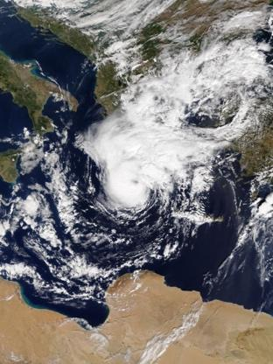
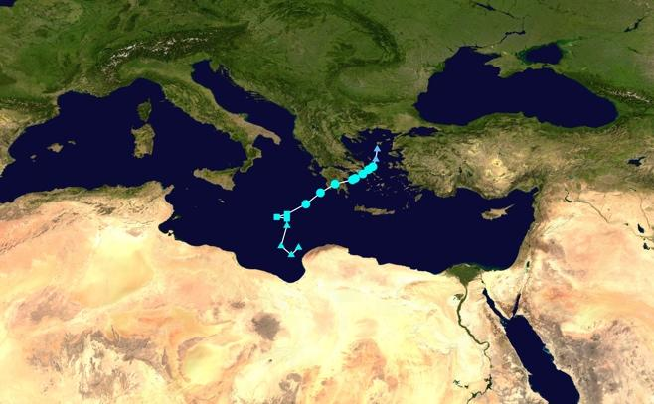
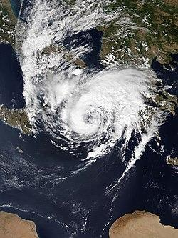
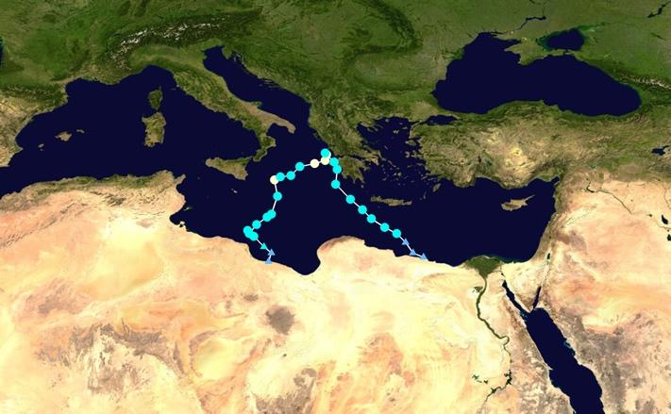
Medicane Zorbas Formed 27 September 2018; Dissipated 2 October 2018
Medicane Ianos Formed 14 September 2020; Dissipated 21 September 2020

Slide 7
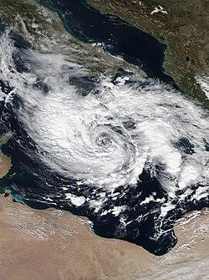
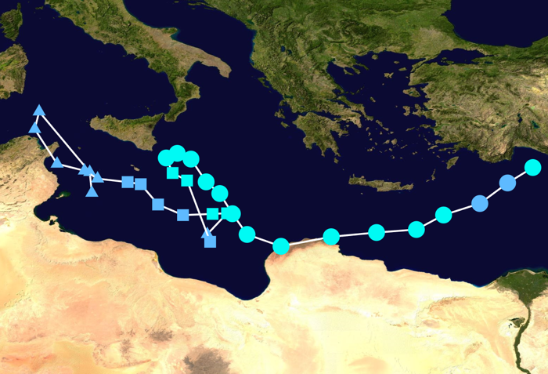
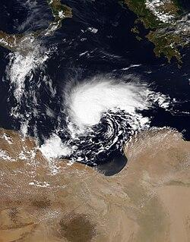
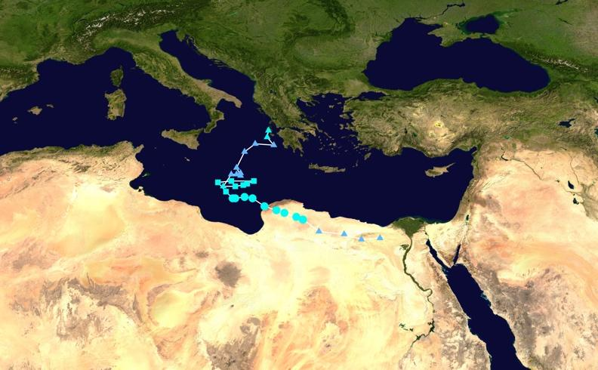
Cyclone Apollo Formed 24 October 2021; Dissipated 2 November 2021
Storm Daniel Formed 4 September 2023; Dissipated 12 September 2023

Slide 8
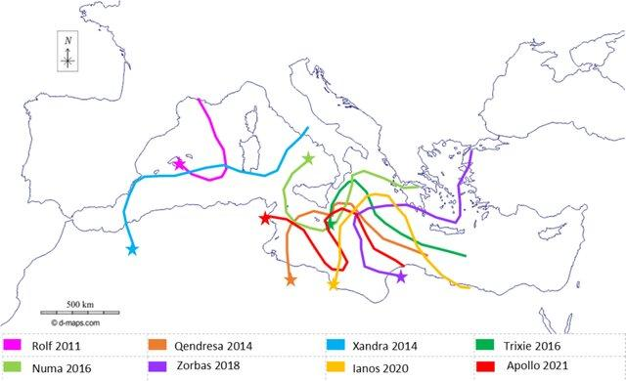
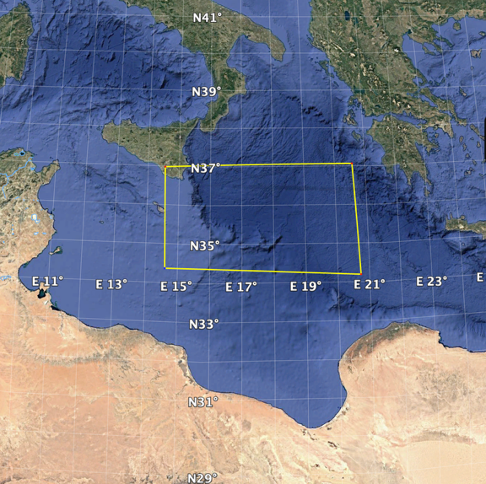
Potential Deploy area2024)
Tracks of some Medicanes that occurred in the Mediterranean Basin between 2011 and 2021(information sourced from Borzì et al. 2024)

